Slide 1
MultiLLM-Using Multiple Cores in a CPU for Communication-Aware LLM Inference Acceleration
SUPERVISED BY TEAM MEMBERS
Prof. Sumit Kumar Mandal
Gayatri Madduri (25804)
Kaushikkumar Rathva (25630)
Siddharth Sethi (25248)
Vedant Balasubramaniam (25024)

Slide 2
Blueprint of the Presentation
1 | LLM: Problems and Challenges
2 | Landscape of Distributed LLM Inferences
3 | Overview of MultiLLM
4 | Methodology
5 | Results
6 | References

Slide 3



LLM: Problems and Challenges
Large Language Models(LLMs) are "large" models with long inference times. Hence, acceleration is essential.
! High Memory
! Slow Inference
! High Energy Use
Multicore CPUs are optimized for low-latency, high-frequency applications, have higher memory capacity, and are more energy-efficient.
Multiple cores are required for leveraging parallelism effectively.
Many cores with lower performance can yield better results than a faster single core in the case of highly parallelizable code.
!
Problem: Communication between CPU cores can be slow and varies significantly depending on the core pair. This becomes a major performance limiter.
Develop a Communication-Aware Mapping Strategy.
GOAL
Communication-Aware inference ensures minimization of synchronization-time overhead.
Profile the target CPU to understand inter-core latencies.
Map LLM layers intelligently, placing frequently communicating layers on low-latency core pairs.
Minimize communication overhead for faster, real-time inference.

Slide 4



Landscape of Distributed LLM Inference
Models often too large for one core; parallelism needed for speed.
Common Types of Parallelism
0 1 0 1 0 1 0 1 0
Data Parallelism
Tensor Parallelism
Pipeline Parallelism
Existing Optimization Approaches
How our we doing it different?
1 | Overlap Communication & Computation: Hide data transfer time while performing computations | CHALLENGES: Imperfect overlap, Bandwidth limits
2 | Reduce Communication Volume: Use quantization or compression | TRADE-OFF: Potential accuracy loss
3 | Advanced Communication Primitives: Hierarchical All-to-All, Collective Decomposition | Often for large multi-node training
4 | Heterogeneous Scheduling: Leverage CPU + GPU | Focus on real-time DNNs
Focus on Intra-CPU Inference Mapping.
Use Empirical, Hardware-Specific Inter-Core Latency Measurements to guide mapping decisions.
Directly tackle the often-overlooked communication bottleneck within a single multicore chip.

Slide 5
Overview of MultiLLM
Divide the given model into compute blocks and calculate the communication volume between these blocks.
Model
Profiling
Block to block communication volume
Block to Core Mapping
Execute Mapping
Core to core latency
Map pairs of cores with less latency to compute blocks with less communication volume.
Launch multiple processes for each compute block to execute it on its assigned core.
CPU Profiling
Understand the core memory and communication times for each core in the CPU.
Continue the process for all layers in an LLM.

Slide 6
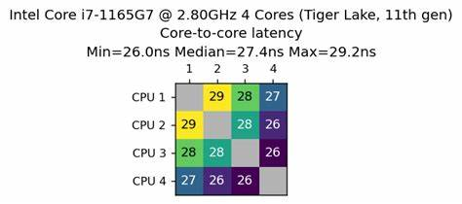
Methodology
CPU Profiling
We measure the communication time between two cores in CPU by transmitting an unsigned integer to the other core.
This module doesn't have any inputs.
The output is the number of cores, and pair-wise communication latency between the cores.
We also take note of the memory within each core to determine if a compute block can fit in a core.
Figure : An example of output from CPU profiling: A matrix,[a_{ij}], of size N×N, where N is the total number of cores.

Slide 7
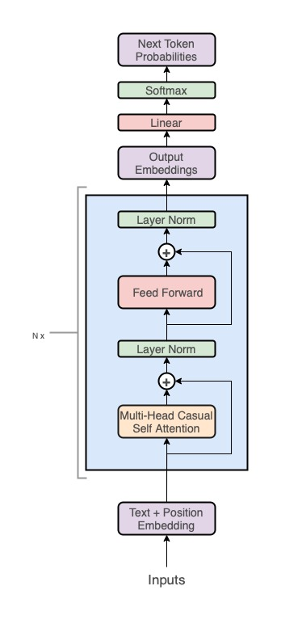
Methodology
INPUT
OUTPUT
Model Profiling
Identify sub-layers within a single Linear Layer(Self-Attention, RMS Norm, Feed-Forward, SwiGLU, Softmax, Linear).
Group into Compute Blocks (units for mapping). Split large sub-layers if needed (memory constraint).
Determine for each block:
Memory Requirement: Weights + Activations.
Communication Volume: Size of data transferred to the next block (e.g., activation tensor size).
Compute Blocks

Slide 8
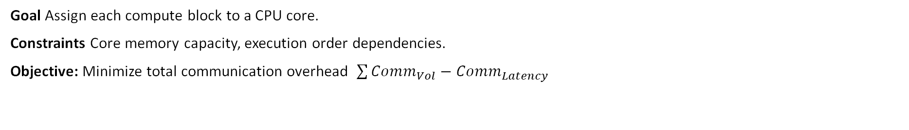
Methodology
Layer to Core Mapping
Goal Assign each compute block to a CPU core.
Constraints Core memory capacity, execution order dependencies.
Objective: Minimize total communication overhead $\sum{Comm_{Vol}−Comm_{Latency}}$
MAPPING APRROACHES
Heuristic Method (Algorithm 2):
💡Idea: Place blocks with high communication volume (consecutive blocks) on core pairs with low latency.
For each core c₁, find closest (c₂) and 2nd closest (c₃) cores (latency-wise).
When mapping block k to c₁, try mapping block k+1 to c₂. If c₂ is taken, try c₃.
Benefit: Fast, practical approximation.
Output: A dictionary {Compute Block ID: Assigned Core ID}
Exhaustive Search
Try all valid block-to-core assignments.
Calculate total communication cost for each.
Select the absolute minimum.
Drawback: Computationally infeasible (combinatorial explosion).

Slide 9
Methodology
Bringing it Together - Multi-Core Execution
Algorithm 3: Process Creation & Execution
Input: The Block-to-Core mapping dictionary. For each Compute Block: Create a dedicated OS Process (multiprocessing.Process) targeting the layer's function. Pin Processes: Use CPU Affinity (os.sched_setaffinity) to lock each process to its assigned core ID from the mapping. Crucial step! Setup Communication: Create IPC Pipes/Queues between processes for connected blocks.
Execution Pipeline Flow
Input sent to Process 1 (on assigned Core A). Process 1 computes, sends output via Pipe to Process 2 (on assigned Core B). Continues sequentially through all blocks/processes/cores. Final output collected from the last process.
BENEFIT: Enables continuous, pipelined processing for real-time applications..

Slide 10
System Specifications
Architecture: x86_64
CPU(s): 256
Thread(s) per core: 2
Model name: AMD EPYC 9554 64-Core Processor
L1d cache: 4 MiB
L1i cache: 4 MiB
L2 cache: 128 MiB
L3 cache: 512 MiB

Slide 11
Results
For Llama
Without Parallelization |  | With Parallelization
Quantity | Value | Quantity | Value
Cycles | 4,076,951,477,277 | Cycles | 10,259,596,330,964
Instructions | 1,113,062,923,380 | Instructions | 1,713,560,742,716
Total time Elapsed | 85.116757868 s | Total time Elapsed | 159.833707000 s
Page Faults | 11,509,267 | Page Faults | 14,470,785

Slide 12
Results
For GPT2_PICO
Without Parallelization |  | With Parallelization
Quantity | Value | Quantity | Value
Cycles | 6,356,796,306,034 | Cycles | 24,020,593,767,842
Instructions | 2,882,026,219,170 | Instructions | 16,195,943,974,725
Total time Elapsed | 31.674932681 s | Total time Elapsed | 38.135483314 s
Page Faults | 820,826 | Page Faults | 1,053,585

Slide 13
References
Z. Wang, H. Lin, Y. Zhu, and T. S. E. Ng, “Hi-speed dnn trainingwith espresso: Unleashing the full potential of gradient compression with near-optimal usage strategies,” EuroSys ’23.
N. Viennot, “Core-to-core latency,” https://github.com/nviennot/core-to-core-latency.git 2025.
W. Kang, K. Lee, J. Lee, I. Shin, and H. S. Chwa, “Lalarand: Flexible layer-by-layer cpu/gpu scheduling for real-time dnn tasks,”RTSS
L. Zhao, W. Gao, and J. Fang, “Optimizing large language models on multi-core cpus: A case study of the bert model,” 2024.

